Slide 1

River Dart Rowing Club
AGM
October 2025

Slide 2
Agenda
Cold Water Shock
Chairman’s report
Forming of the new committee

Slide 3
Agenda
Cold Water Shock
Chairman’s report
Forming of the new committee

Slide 4

Aims of the River Dart Rowing Club Committee 2023 to 2025
After our time on the committee to leave the club in a healthier state than the one we inherited. Namely:
A more buoyant membership including more younger members
Ensure our income does not exceed our spend
To provide our members with plenty of opportunity to be afloat with our standard rows, special social events and racing
To have better maintained boats and equipment
To be safer afloat
To ensure our membership and the wider community, are fully abreast with current, relevant and interesting information
To have a clear identity as the River Dart Rowing Club

Slide 5
A more buoyant membership including more younger members
Membership numbers:
    51 in 2023
    64 in 2024
    65 in 2025
      14 new member in 2025
      4 on the waiting list
Healthy split between Kingswear and Dartmouth
  Very close to 50:50
No joy at all with younger members
Note:
We revised our strategy in 2025 as we have not attracted any younger members

Slide 6
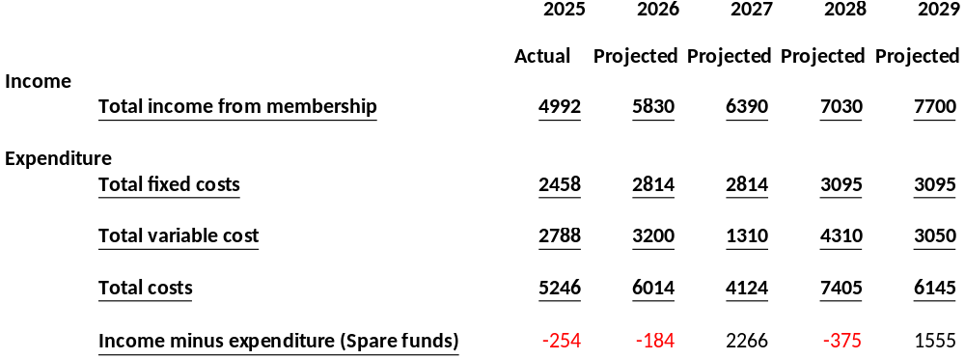
Ensure our income does not exceed our spend
Membership costs versus expenditure
Running costs to be covered by membership cost

Slide 7
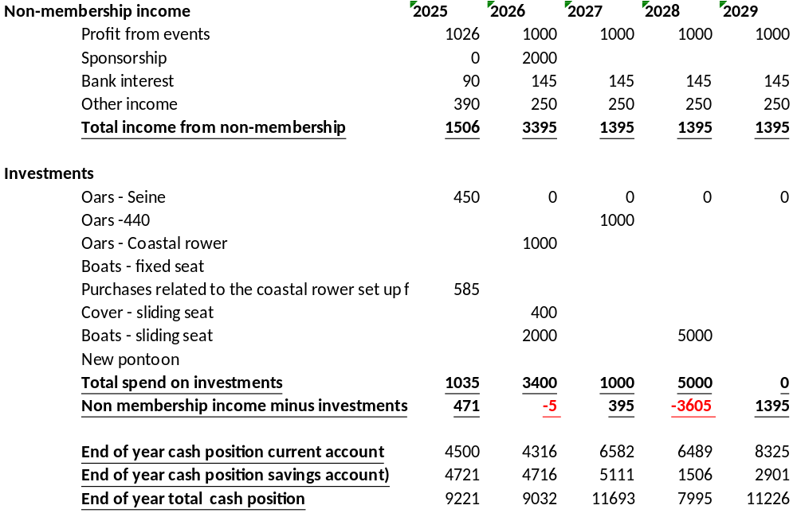
Ensure our income does not exceed our spend 5 Year Investment Plan and cashflow
Investments to be covered by non membership income
What to do about our pontoon is not accounted for in these costs

Slide 8
Ensure our income does not exceed our spend
Our club pontoon
Options | Advantages | Disadvantages | Our recommendation
Do nothing | It potentially avoids any cost | This will not be looked on favourably by: Our landlord The Kingswear residents It is the wrong thing to do
Invest in short term to make her safe | We will possibly have another couple of years use of the pontoon | Our use of the pontoon has altered. It is now only about storage. We would need to invest a couple of thousand. The cost of storage elsewhere would be cheaper over a couple of years If the pontoon sinks in the meantime – disposal costs will be much higher given the inaccessibility of the site
Dispose of it whilst it still floats, via a boatyard | It is a far cheaper option than breaking it up on site | It is a cost we have not budgeted for. It will eat hugely into our savings

Slide 9
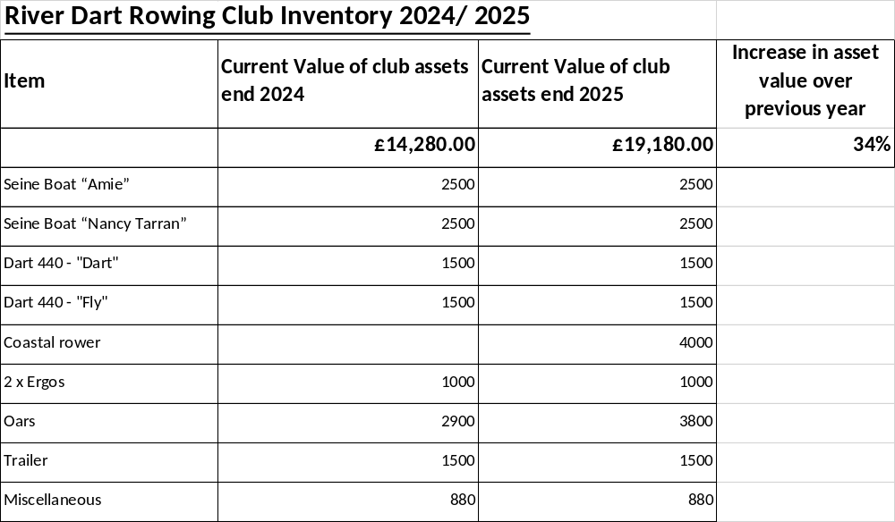
Ensure our income does not exceed our spend
We understand our asset value

Slide 10
2025 Awards
Award | Trophy
Chairman’s award for service to the club | The Shield
Best lady | Wendy Ryan cup
Best open | Bob Honeyfield cup
Most improved lady | Chris Ryan trophy

Slide 11
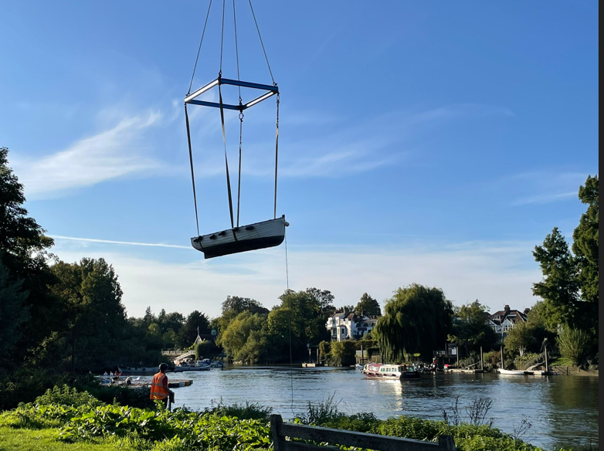
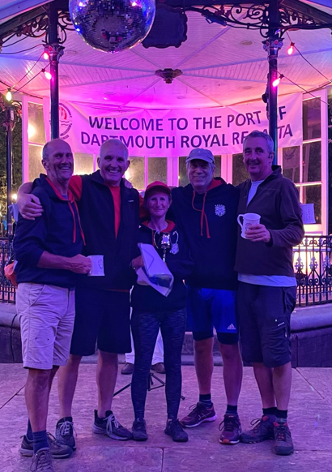
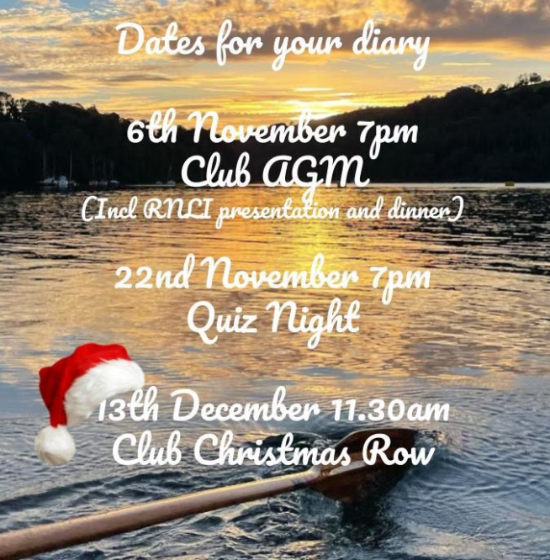
To provide our members with plenty of opportunity to be afloat with our standard rows, special social events and racing
Private rows
Standard rows
  440s back on the water – can accommodate 1 – 18 rowers!
Racing
  Seine boats in Royal Dart regatta - 25 members present
  Head of Dart
  Great River Race
  Lay up seine boat race
Special events
  Christmas row
  Solstice row
  Pizza row

Slide 12
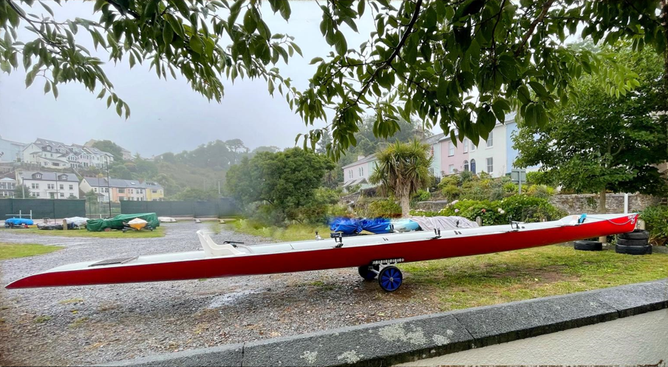
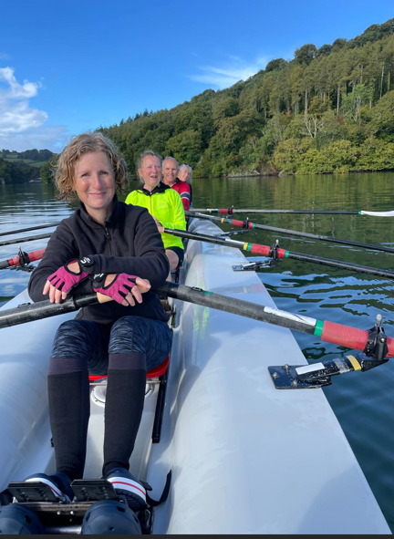
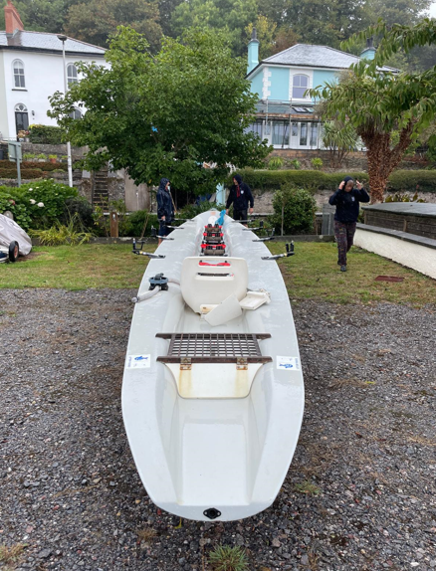
To provide our members with plenty of opportunity to be afloat with our standard rows, special social events and racing
At the end of August, we took receipt of our coastal rower

Slide 13
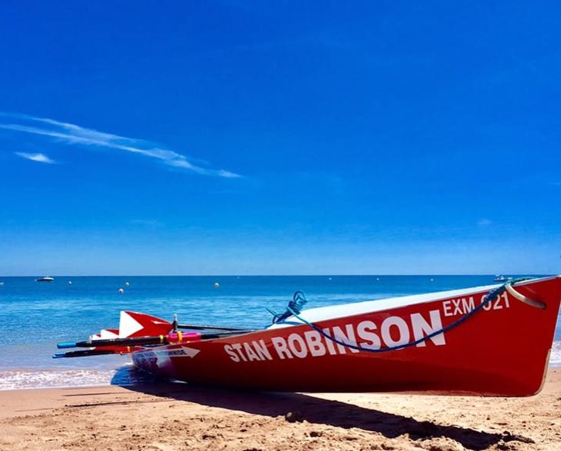
To provide our members with plenty of opportunity to be afloat with our standard rows, special social events and racing
Name the boat
Non-water event – Skittles earlier in the year
Next event will be the quiz night in November
Kerry

Slide 14
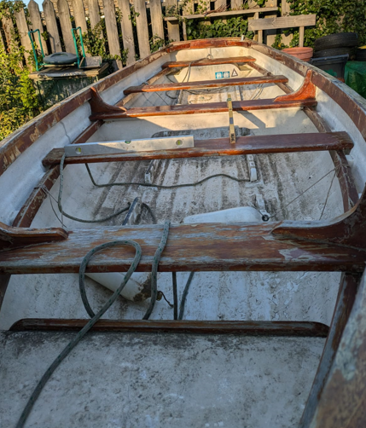
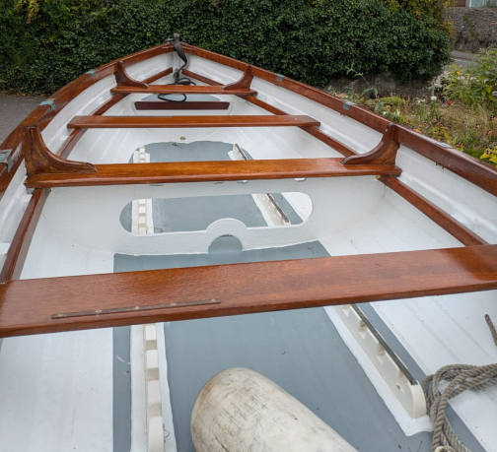
To have better maintained boats and equipment
We have purchased 9 second hand oars for the seine boats
Planned Maintenance Schedule – 2 to 3 year cycle
Equipment | 2024 | 2025 | 2026 | 2027 | 2028 | 2029
Seine boats | Morwenna | Nancy | Amie | Morwenna | Nancy | Amie
Dart 440s |  | Dart | Fly |  | Dart | Fly
Seine oars | Set 1, Set 2 |  | Set 3, Set 4 | Set 5 and 6 | Set 1, Set 2 | Set 3, Set 4
Dart 440 oars |  |  |  | Set 1 | Set 2 *
Trailers |  |  | Trailer 1 | Trailer 2 | Trailer 1 | Trailer 2
Maintenance of coastal rower and its oars, our maintenance strategy is not yet clear
* - not yet purchased

Slide 15
2025 Awards
Award | Trophy
Most improved open | Bob Honeyfield trophy
Best newcomer | Rutherford Dyer trophy
Ladies Crew of the Year | D salva
Open Crew of the Year | K salva

Slide 16
To be safer afloat
Safety bags
New risk assessment completed
Revised rowers guide will soon be ready for distribution
Bosun and Safety Officers What’s app groups in place
Man overboard training
Coxes test has been broadened

Slide 17
To ensure our membership and the wider community, are fully abreast with current, relevant and interesting information
Communication via What’s app
  Vast majority of club is on What’s app
  Most of our current activity is on this platform
Website
  Installed in 2024
Social media
 | No. of Followers | Views (prev 28 days) | Best post views
Facebook | 188 | 3078 | 1500
Instagram | 194 | 1800 | 369

Slide 18
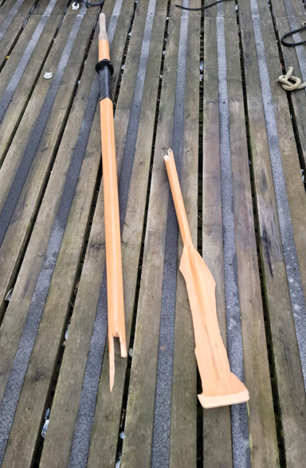
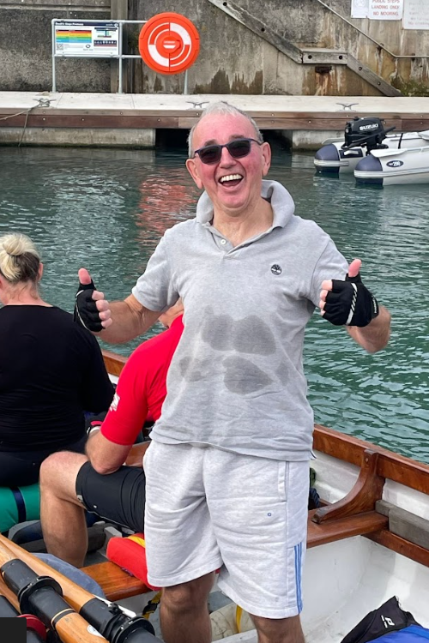
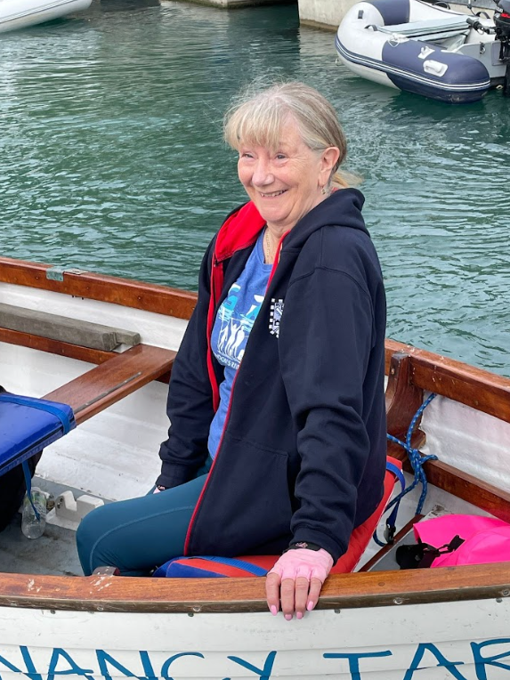
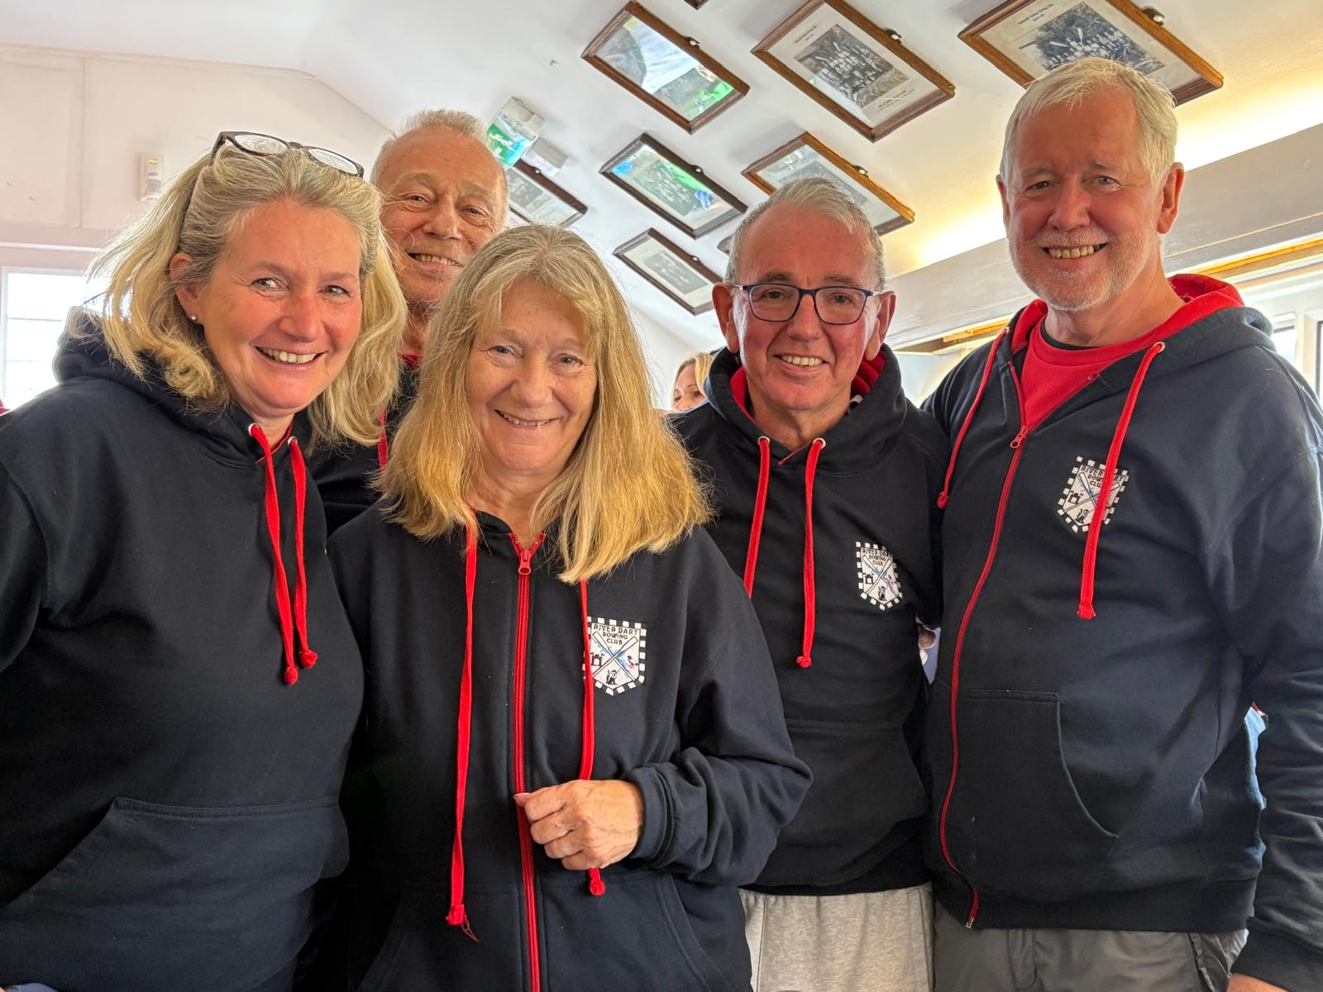

2025 Awards
Award | Trophy
Mixed Crew of the year | S salva
Coxswain of the year | Kingswear cup
Embracing the spirit of the club | Challenge Trophy
Calamity Cup | St. Thomas trophy

Slide 19
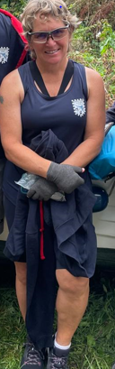
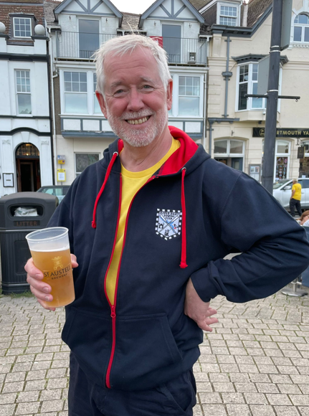
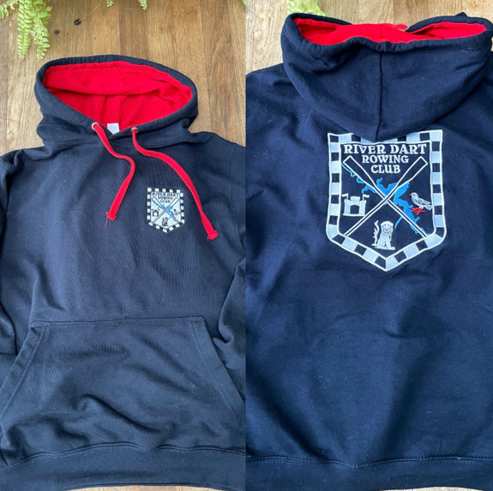
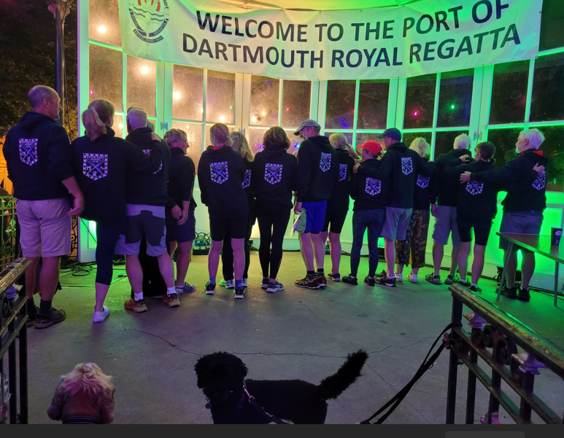
To have a clear identity as the River Dart Rowing Club
Migration from Kingswear Rowing Club is completed in 2024
  Roughly half of the membership now comes from Dartmouth
We have a wonderful club badge
Hoodies/ racing vests and winter hats
Our identity has been a successful tool in generating new membership!

Slide 20

Before we take questions. A big thank you to the committee for meeting most months and moving the club forwards

Slide 21
Agenda
Cold Water Shock
Chairman’s report
Forming of the new committee

Slide 22
Our present committee:
Role | Who
Chairman | Noel Cornforth 1
Treasurer | Janine Carter 2
Membership Secretary | Andrea Cates 1
Health and Safety Officer | Allan Scobie 1
Bosuns | Steve Moroz 2 and Simon Rushton 3, Steve Redmond 3
Water events | Kerry Rushton 1
Social land events | Sue Merotra 1
Social media and website | Tor Allan 1
1. Completed 2 years and offering to remain in post
2. Standing down
3. Co-opted onto the committee during the term

Slide 23
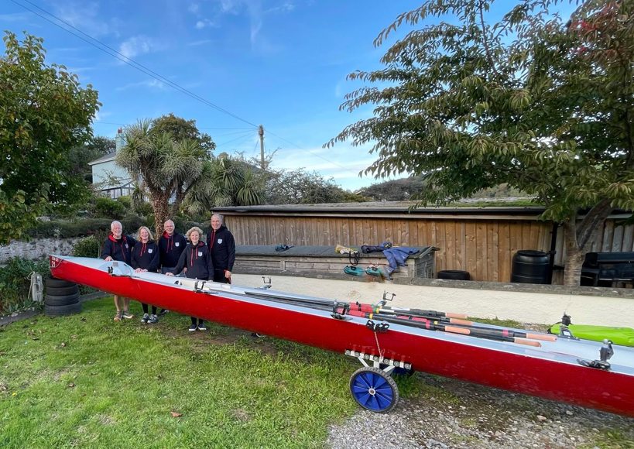
The 2026 committee
Vacant positions
  Treasurer
Role | Who
Chairman | Noel Cornforth
Treasurer | Christina Carmichael
Membership Secretary | Andrea Cates
Health and Safety Officer | Allan Scobie
Bosuns | Simon Rushton and Steve Redmond
Water events | Kerry Rushton
Social land events | Sue Merotra
Social media and website | Tor Allan

Slide 24
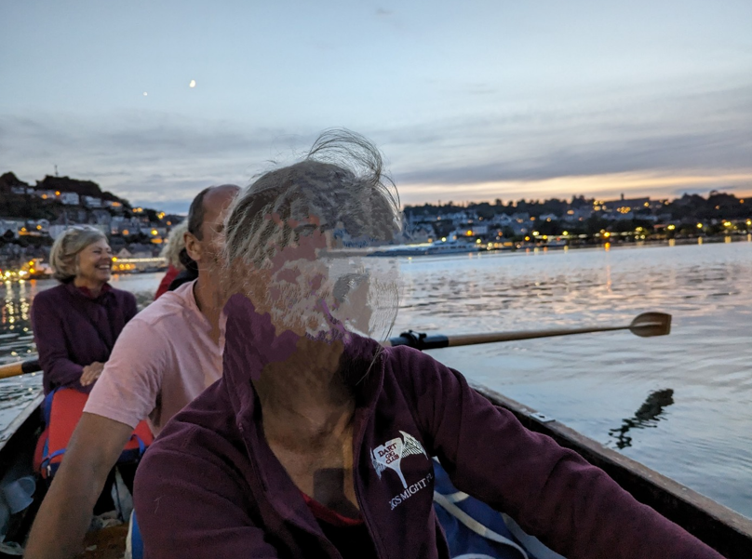
2025 Awards
Award | Trophy
Club photographer of the year | Lucy Payne cup
Best team player on the water | Dart cup
Best team player off the water | Devon cup

Slide 25
A

Slide 26
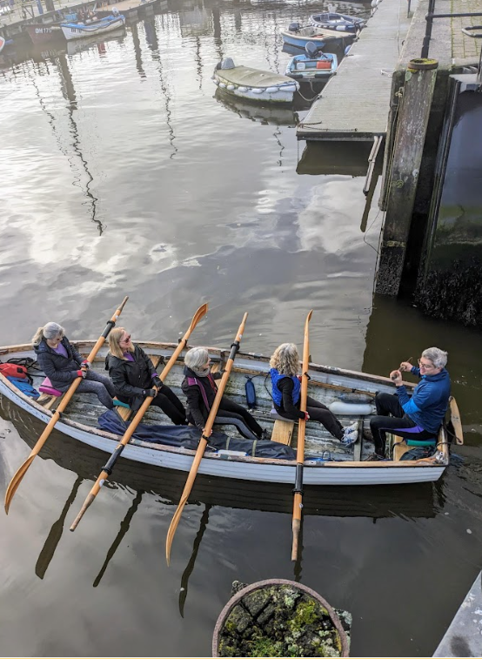
B

Slide 27
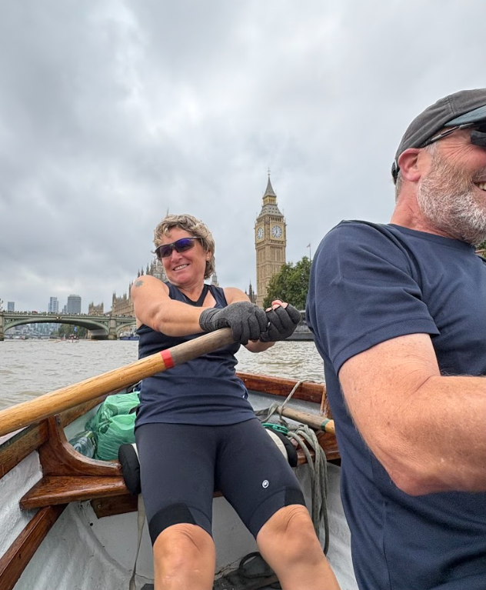
C

Slide 28
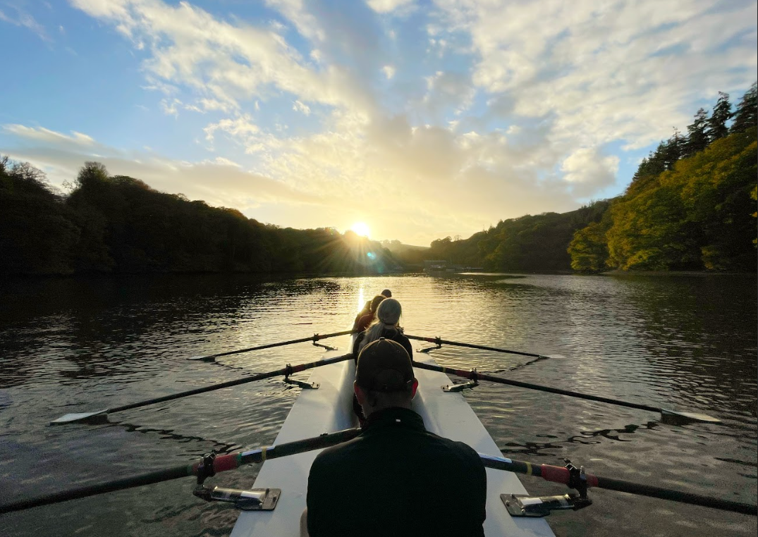
D

Slide 29
2025 Awards
Award | Trophy
Club photographer of the year | Lucy Payne cup
Best team player on the water | Dart cup
Best team player off the water | Devon cup

Slide 30
Award | Trophy | Winner 2025
Chairman’s award for service to the club | The Shield | Steve and Gill Ainsworth
Best lady | Wendy Ryan cup | Mary
Best open | Bob Honeyfield cup | Allan
Most improved lady | Chris Ryan trophy | Linda
Most improved open | Bob Honeyfield trophy | Rob
Best newcomer | Rutherford Dyer trophy | Nickie
Ladies Crew of the Year | D salva | Regatta Women: Linda, Margaret, Lucinda Harvey, Jo Griffin, Kerry
Open Crew of the Year | K salva | Men’s Over 45 regatta crew: Cliff, Ed, Noel, Allan and Tor
Mixed Crew of the year | S salva | GRR crew : Kerry, Simon, Sian, Keith, Colin, Tor
Coxswain of the year | Kingswear cup | Tor
Calamity Cup | St. Thomas trophy | Rob
Embracing the spirit of the club | Challenge Trophy | HOD B Team: John J, John L, Nickie, Andrea
Club photographer of the year | Lucy Payne cup | Tor Allan
Best team player on the water | Dart cup | Sian and Keith
Best team player off the water | Devon cup | Kerry

